Slide 1

xAI-Proj-B: Explainable Machine Learning
Final Presentation
Abeera Ayesha Riaz
Haris Mustafa
Bonneau Russel Atiodjia Jiokeng
Tchouli Nzeukeyo Ulrich Midrel
07.02.2024

Slide 2
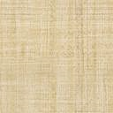
Aim of the project
Image recognition from MNIST and MedMNIST datasets using Deep Learning.
The idea here is to use the same principle of human neuron function to create artificial neurons capable of recognizing images.
In the course of the project, we used Python as our programming language, with Pytorch as the main module.
Two different datasets
  MNIST
  MedMNIST

Slide 3
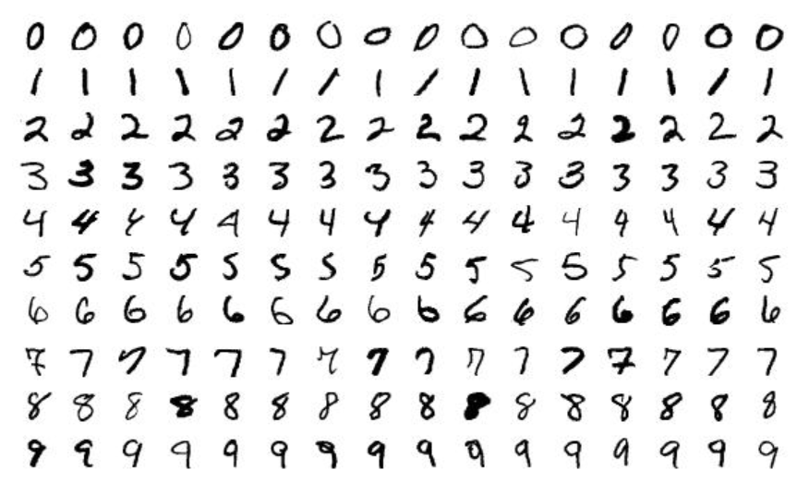
MNIST Dataset
The MNIST dataset contains 28 x 28 centred greyscale images of handwritten digits (0 - 9).
It has 60,000 training examples and 10,000 testing examples.
The goal is to classify the handwritten digits

Slide 4
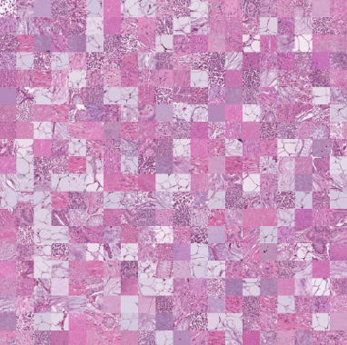
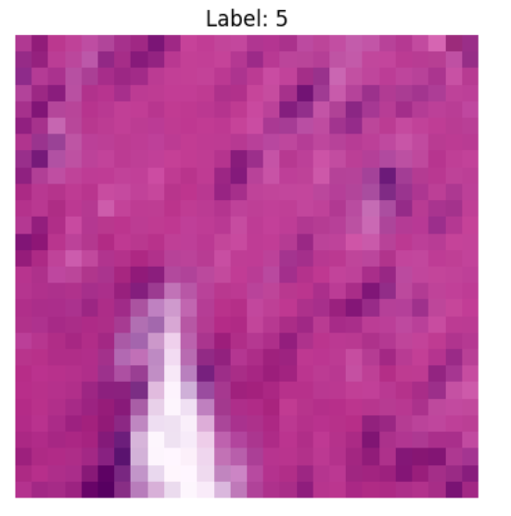
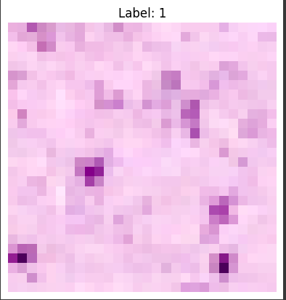
MedMNIST Dataset
PathMNIST dataset contains 28 x 28 centered images of 9 tissue classes.
It has 77,180 training and 30,000 testing examples.

Slide 5
Methodology
We decided to use 2 training models for MNIST and MedMNIST datasets and compare the results with each other to see which approach produces better results.
We chose to implement
  Convolutional neural network - CNN
  Residual Network – ResNET

Slide 6
CNN & ResNet
Convolutional neural network is a feed-forward neural network that uses convolutional layers to apply convolution operations to input data.
Residual Network (ResNet) is a Convolutional Neural Network (CNN) architecture that overcame the “vanishing gradient” problem that occurs during backpropagation. It helps in maintaining a low error rate in the deeper network by facilitating the flow of gradients through the network.
In the next slides we will explain how we have implemented CNN and ResNet on both datasets.

Slide 7
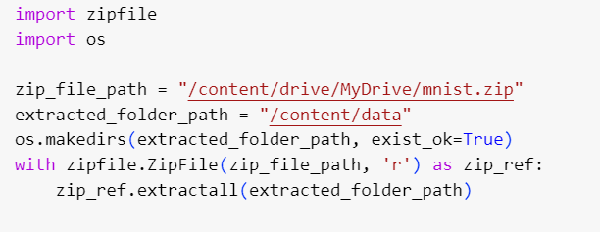
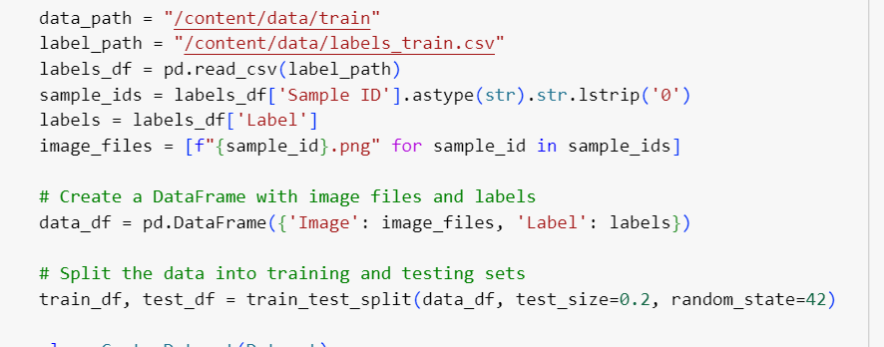
Image Preprocessing
The first step in applying a model to a dataset is to process the images first.
MNIST image preprocessing is simple where we extract the images from a zipped folder and read the labels file for labels of training images.

Slide 8
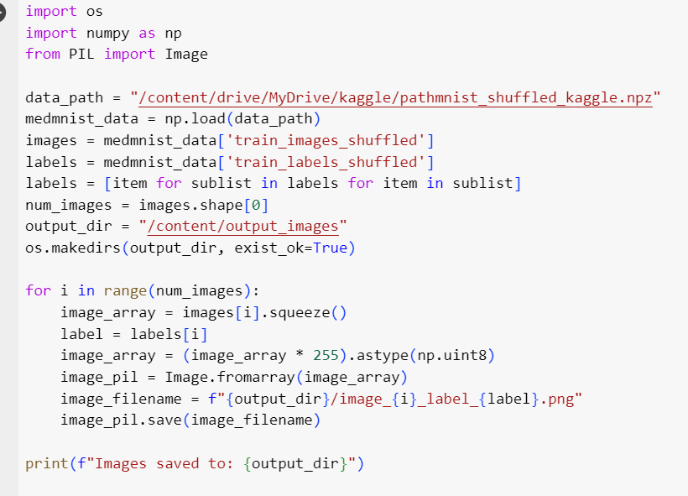
Image Preprocessing
For MedMNIST the code starts by creating a list of image filenames based on the provided labels

Slide 9
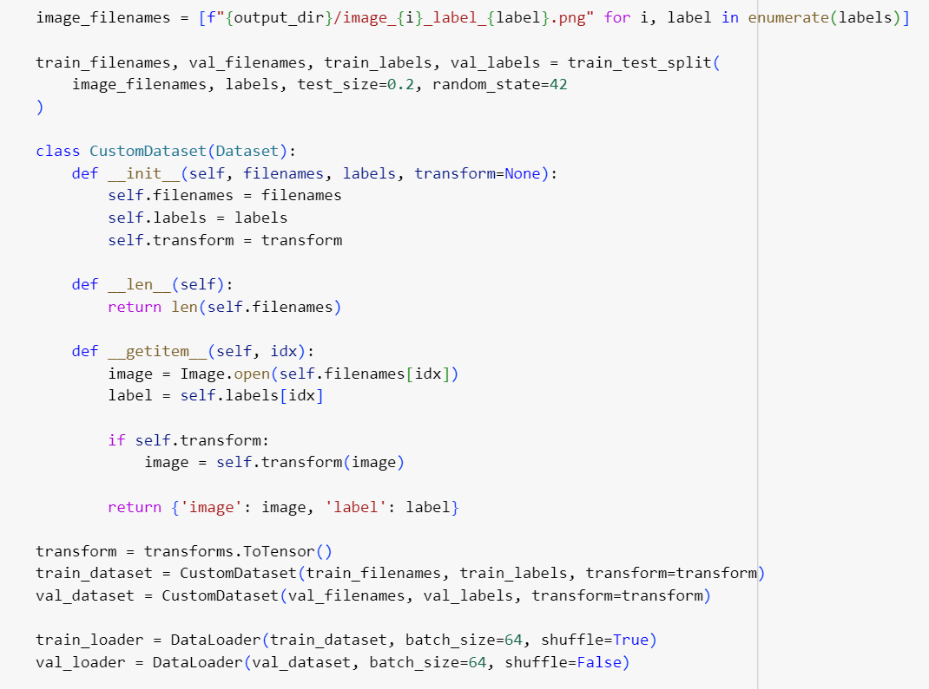
CNN – Data Preprocessing
The CustomDataset class is defined to load and preprocess the images for training and validation. It uses the transforms.ToTensor() transformation to convert images into PyTorch tensors.
We split the training images into training set and validation set with train_test_split function.
We are also using a batch size of 64.

Slide 10
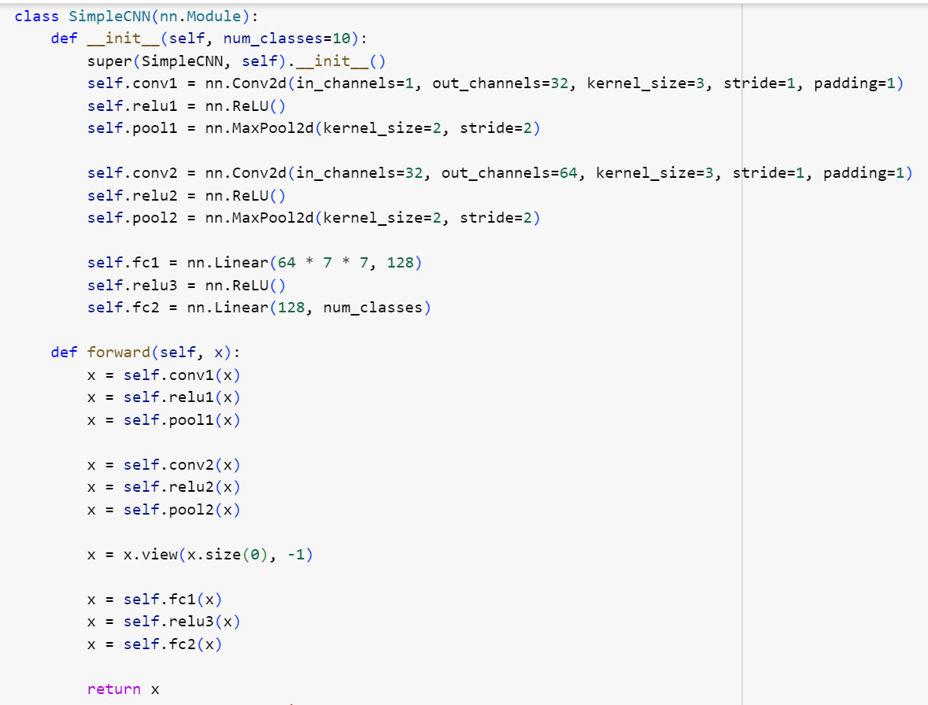
CNN – Training the Model
The model is a Convolutional Neural Network designed for multi-class classification (with 9 classes).
It consists of two convolutional layers (conv1 and conv2) with ReLU activation functions and max-pooling layers (pool1 and pool2) for down-sampling.
Two fully connected layers (fc1 and fc2) follow the convolutional layers for classification.
The output layer has a number of units equal to the number of classes (9 in this case).
ReLU activation functions are applied after the convolutional layers and the first fully connected layer.

Slide 11
CNN – Training the Model
Input channels of the first convolutional layer (in_channels=3) correspond to the color channels of the images (assuming RGB images). This is a common choice for color images where each pixel has three values (Red, Green, Blue).
Output channels of the convolutional layers (out_channels=32 and out_channels=64) represent the number of filters or features learned by these layers. Increasing output channels allows the model to capture more complex patterns but also increases computational cost.
The output channels of the last fully connected layer (fc2) correspond to the number of classes (9 in this case), as the final layer is responsible for producing class predictions.

Slide 12
CNN – Training the Model
self.fc1 = nn.Linear(64 * 7 * 7, 128): nn.Linear creates a fully connected layer.
The input size for this layer is calculated as 64 * 7 * 7. This comes from the fact that the previous layer (pool2) has 64 output channels, and after applying two max-pooling layers, the spatial dimensions are reduced to 7x7. So, the input to the fully connected layer is flattened to 64 * 7 * 7.
The output size of this layer is set to 128. This means there are 128 neurons in this fully connected layer.
In simple terms, this layer is responsible for transforming the high-level features extracted by the convolutional layers into a format that can be used by the final classification layers.

Slide 13
CNN – Training the Model
self.relu3 = nn.ReLU(): Is the Rectified Linear Unit activation function.
After the output of self.fc1 is computed, it goes through the ReLU activation function. ReLU introduces non-linearity to the model, allowing it to learn complex patterns.
The purpose of this activation function is to introduce non-linearities and increase the model's capacity to learn and generalize.

Slide 14
CNN – Training the Model
self.fc2 = nn.Linear(128, num_classes): Another fully connected layer is defined.
The input size is 128, which is the output size of the previous fully connected layer (self.fc1).
The output size is set to num_classes, which is the number of classes the model needs to classify. In this case, it's 9, as indicated by num_classes=9.
This layer is responsible for producing the final output logits for each class. The model will make predictions based on the class with the highest logit value.

Slide 15
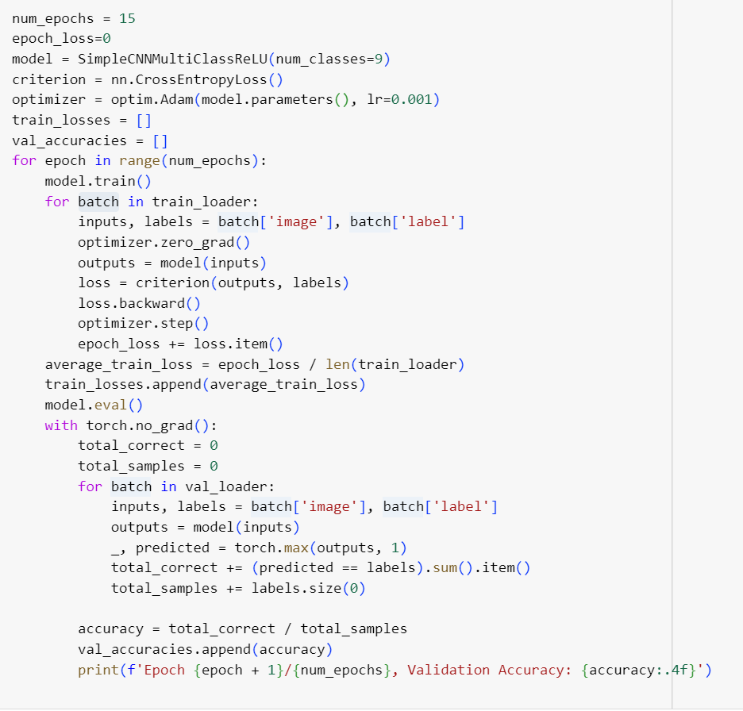
CNN – Training the Model
The model is trained using the CrossEntropyLoss and the Adam optimizer.
Training is done for 15 epochs, where for each epoch, the training loss is calculated and printed. Additionally, the model is evaluated on the validation set, and the accuracy is printed.

Slide 16
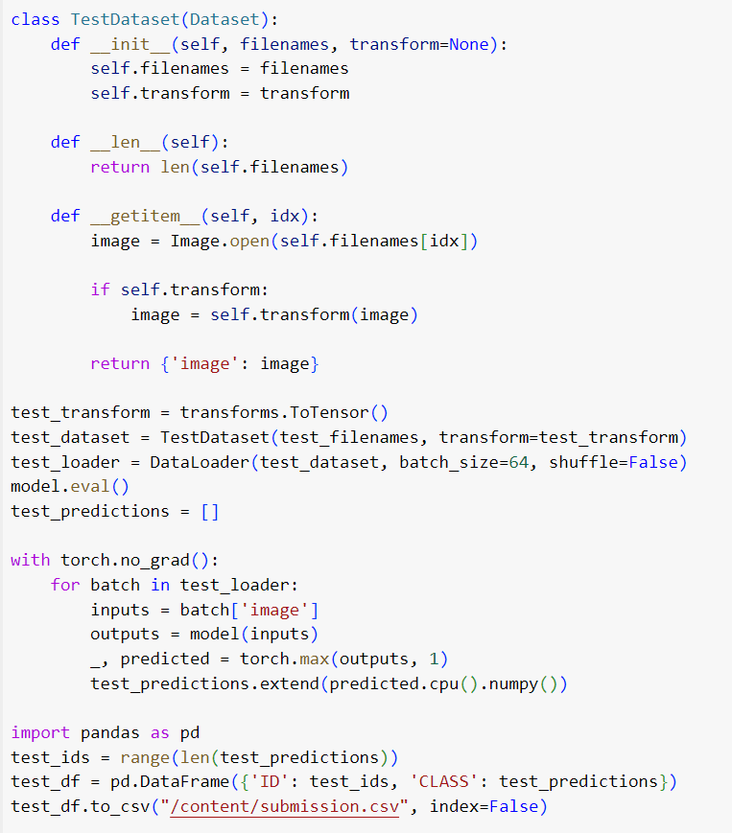
CNN – Testing the Model
Test images are generated and saved to a specified directory.
A TestDataset class is defined similarly to CustomDataset, but it doesn't require labels as it's used for the test set.
The saved test images are then loaded into a DataLoader for batch processing.
The trained model is used to predict the labels for the test set, and the results are saved in a CSV file.
Output: The final output includes a CSV file (submission.csv) containing the predicted labels for the test set.

Slide 17
CNN – Testing the Model
Test images are generated and saved to a specified directory.
A TestDataset class is defined similarly to CustomDataset, but it doesn't require labels as it's used for the test set.
The saved test images are then loaded into a DataLoader for batch processing.
The trained model is used to predict the labels for the test set, and the results are saved in a CSV file.
Output: The final output includes a CSV file (test_predictions_cnn.csv) containing the predicted labels for the test set.

Slide 18
CNN - Improvements
This model is a basic CNN for image classification, and its performance can be further improved through experimentation with hyperparameters, architecture changes, or using pre-trained models.
We will take a look at how ResNet is used on our datasets.

Slide 19
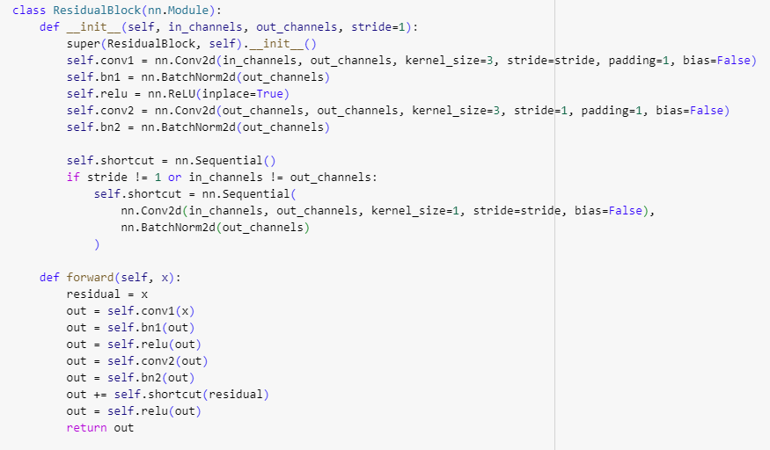
ResNET – Residual Block
The first step in ResNet is to create a ResidualBlock.
The ResidualBlock class defines a single block for the residual network and allows for the training of deeper networks.
It consists of two convolutional layers with batch normalization and ReLU activation functions.
The shortcut connection is introduced to allow the network to skip one or more layers, helping to mitigate the vanishing gradient problem during training.

Slide 20
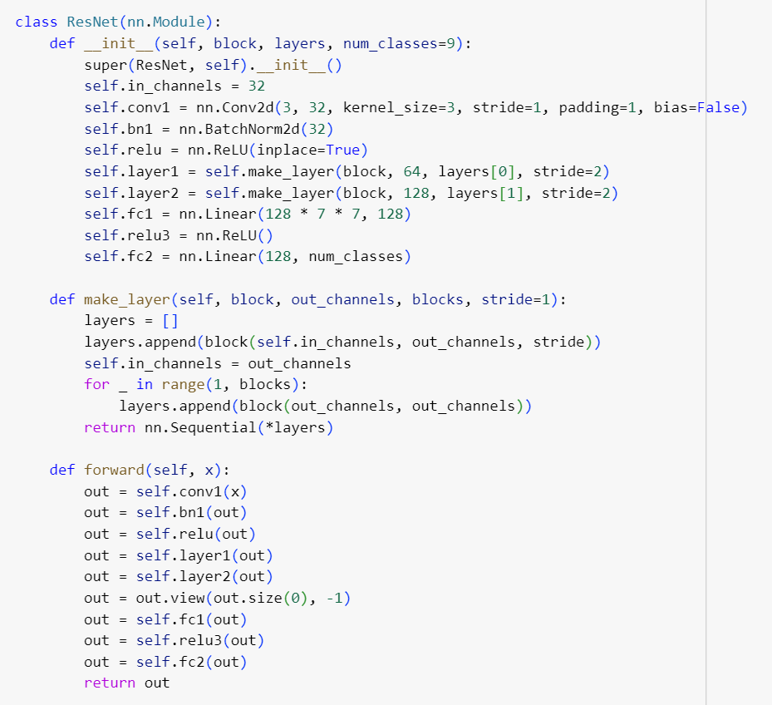
ResNET – Architecture
The main architecture is defined by the ResNet class.
It starts with a convolutional layer (conv1) followed by batch normalization and ReLU activation.
Two residual layers (layer1 and layer2) are implemented using the make_layer method. The make_layer method repeats the residual blocks to form a layer.
The output of the convolutional and residual layers is flattened and passed through fully connected layers (fc1 and fc2) for classification.
ReLU activation is applied after the first fully connected layer.

Slide 21
ResNET – Architecture
Input channels of the first convolutional layer (in_channels=3) correspond to the color channels of the images (assuming RGB images).
Output channels of the first convolutional layer (out_channels=32) represent the number of filters or features learned by this layer.
In subsequent residual layers (layer1 and layer2), the number of output channels increases to capture more complex features.

Slide 22
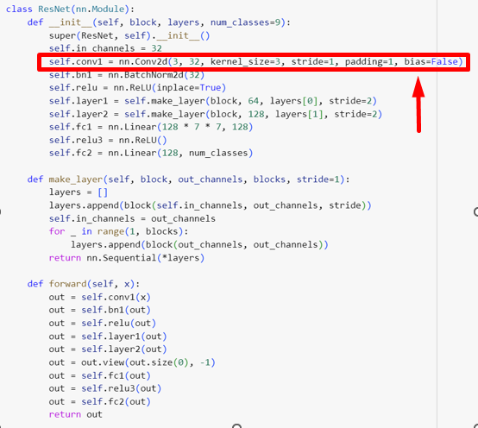
ResNET – Architecture
This line defines the first convolutional layer of the network. nn.Conv2d is a 2D convolutional layer in PyTorch.
The parameters are:
in_channels=3: Input channels, representing the color channels of the input images (assuming RGB images).
out_channels=32: Output channels, i.e., the number of filters. It means this layer will learn 32 different features.
kernel_size=3: Size of the convolutional kernel (3x3).
stride=1: The step size the kernel takes while moving over the input.
padding=1: Padding added to the input to ensure that the convolutional operation does not reduce the spatial dimensions too much.
bias=False: Indicates that this layer does not use bias parameters.

Slide 23
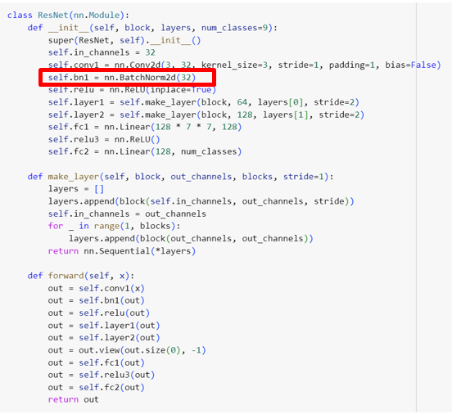
ResNET – Architecture
This line defines the batch normalization layer after the first convolutional layer.
nn.BatchNorm2d is a batch normalization layer for 2D inputs.
It normalizes the output of the convolutional layer, reducing internal covariate shift and helping with training stability.

Slide 24
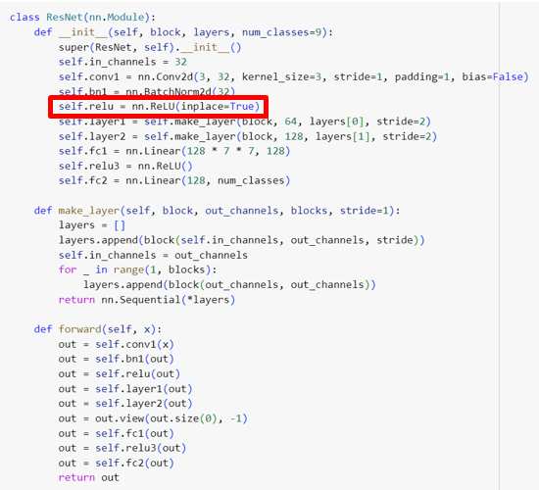
ResNET – Architecture
This line defines a ReLU activation function.
inplace=True means that the operation directly modifies the input tensor, saving memory. It's a computational optimization.

Slide 25
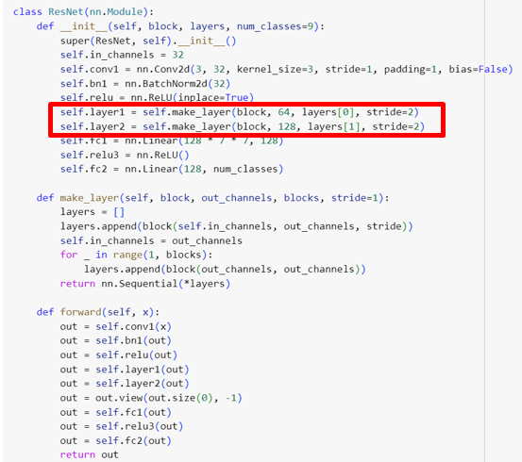
ResNET – Architecture
self.layer1: This line defines the first residual layer (layer1) using the make_layer method.
It specifies that layer1 will consist of layers[0] residual blocks, each increasing the number of output channels from 32 to 64.
The stride=2 indicates that the stride of the first convolutional layer in each residual block is set to 2, resulting in a down-sampling of the spatial dimensions.
self.layer2 = Similar to the previous line, this defines the second residual layer (layer2), but now the number of output channels is increased to 128.

Slide 26
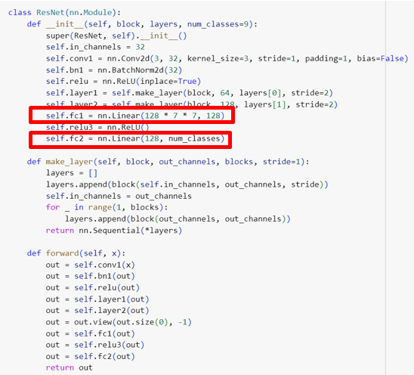
ResNET – Architecture
self.fc1: This line defines the first fully connected (linear) layer.
The input size is calculated as 128 * 7 * 7, where 128 is the number of output channels from the last convolutional layer, and 7x7 is the spatial size after the residual layers.
The output size is set to 128.
self.fc2: This line defines the final fully connected layer.
The input size is 128 (output size of the previous layer), and the output size is set to num_classes, which is 9 in this case.

Slide 27
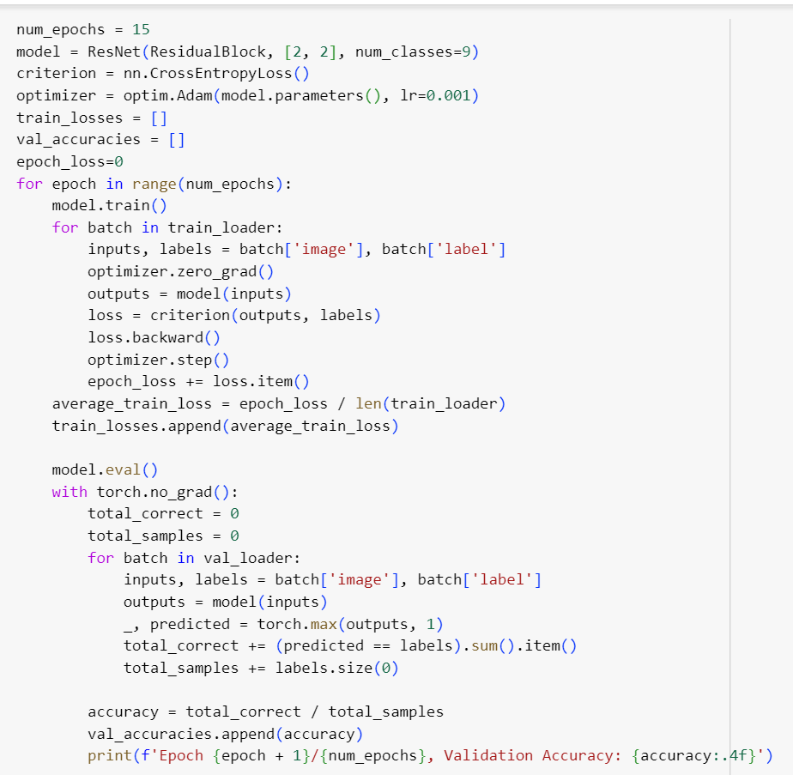
ResNET – Training and Optimization
The model is trained for 15 epochs using the CrossEntropyLoss and the Adam optimizer.
Further tuning and experimentation with hyperparameters can improve performance.

Slide 28
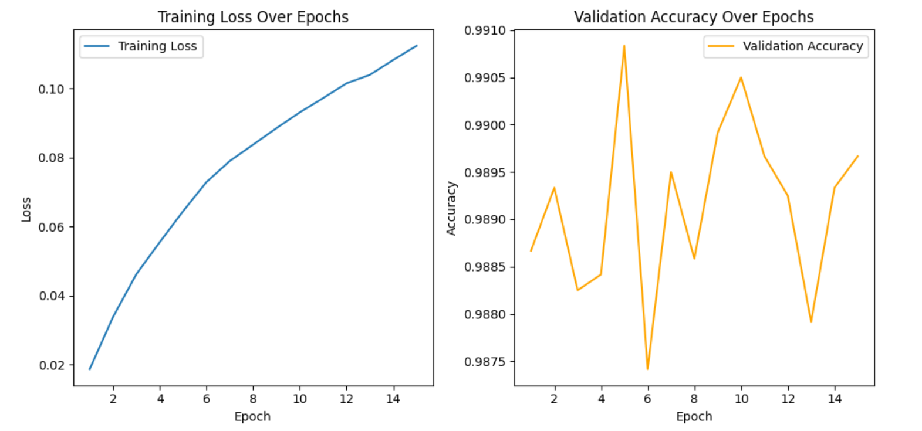
Results - MNIST CNN

Slide 29
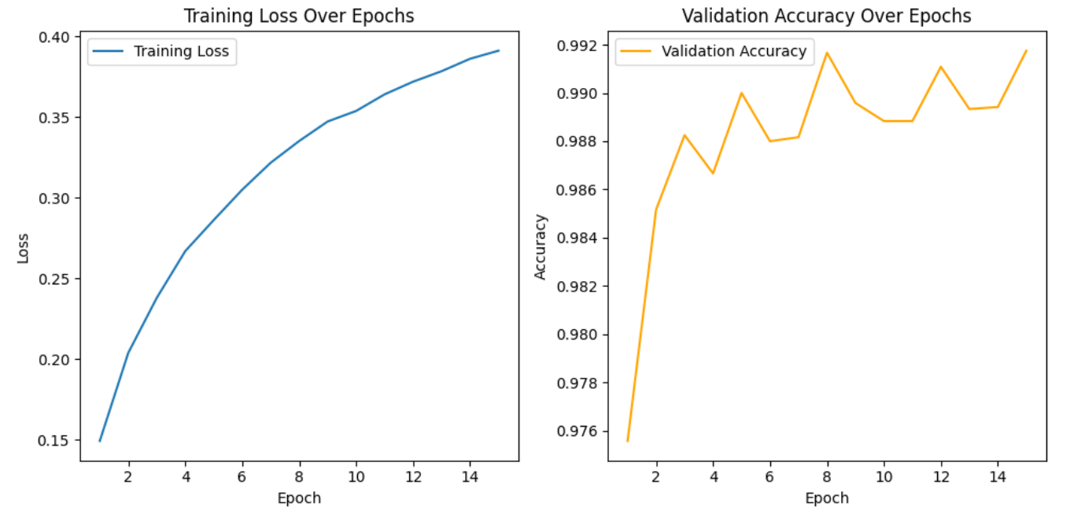
Results - MNIST ResNet

Slide 30
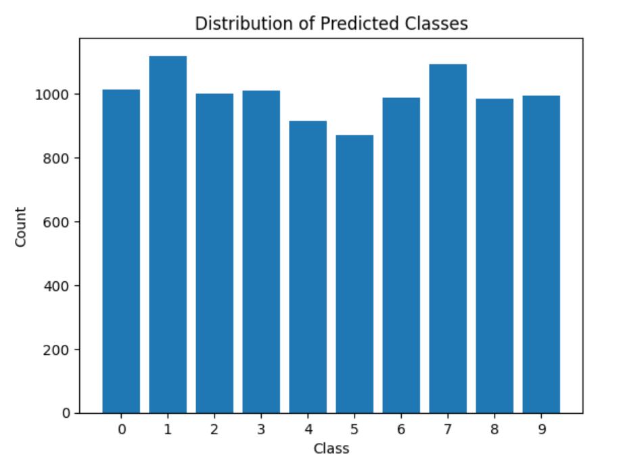
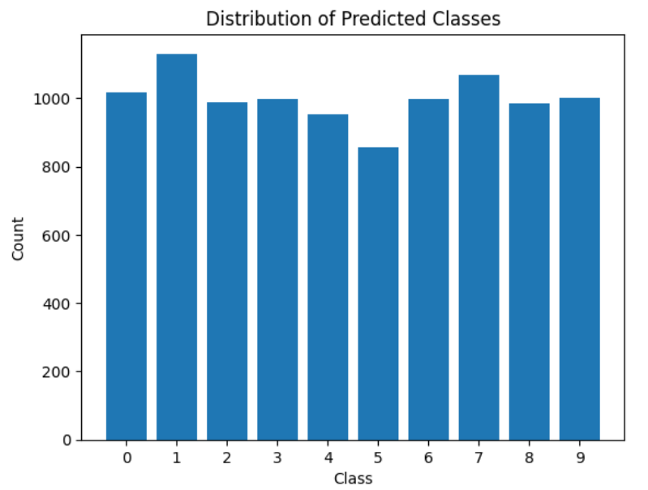
Results - MNIST Predicted Classes
CNN
ResNet

Slide 31
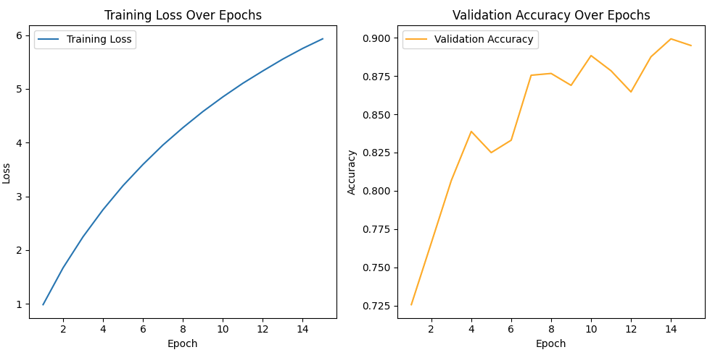
Results - MedMNIST CNN

Slide 32
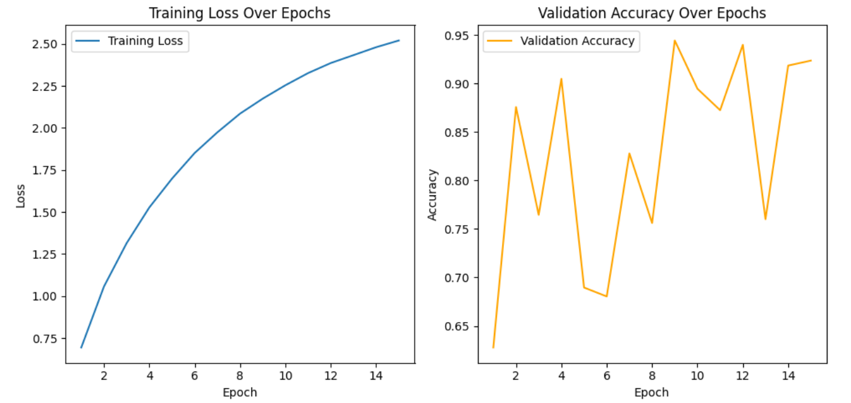
Results - MedMNIST ResNet

Slide 33
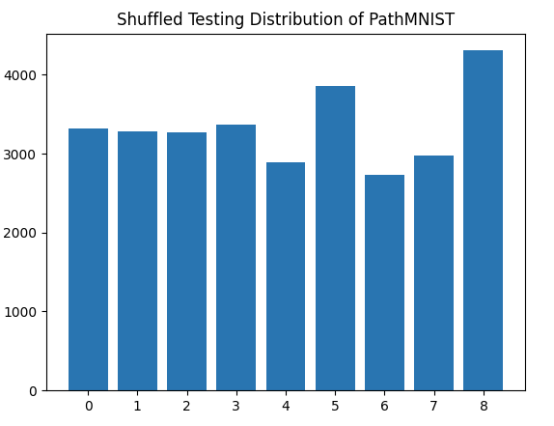
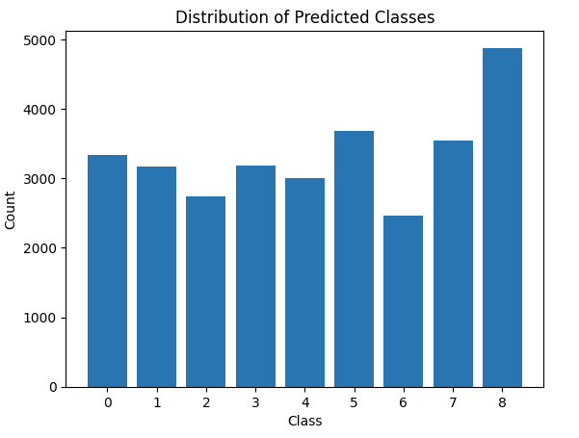
Results - MedMNIST Predicted Classes
Real
CNN

Slide 34
Thank You
Any Questions?

